Slide 1
Mini project
Self Balancing Robot
Group No. 8
Nikhil K J
Jisha Albert
Jineesh P
Jaison Joshi
Guided by:
Asst. Prof. VishnuPrasad K
Dept. of ECE

Slide 2
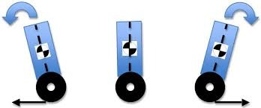
Abstract
A robot that will balance on two wheels and be able to have loads of varying weight and size placed on the top platform. It will be capable of handling disturbances including bumps from humans or running into stationary objects and it can accommodate flooring changes (carpet, tile etc.) while maintaining balance.
An accelerometer and a gyroscope feed information back to the microcontroller which feeds a PWM signal to two motors that drive the wheels so they stay under the center of mass of the robot.

Slide 3
introduction
Two Wheeled Self Balancing Robot is a foremost research topic in the area of robotics and control engineering.
The principle of operation behind a self balancing robot is an inverted pendulum concept.
The major focus on this project is the hardware development of a two wheeled self balancing robot for an application to carry objects from one place to another.

Slide 4
advantages
Precise navigation in tight spaces
Rotate in place to instantly change its direction of motion
Humanoid look

Slide 5
Facilities & TOOLS required
Project Lab
ARDUINO IDE
SketchUp
Adobe CorelDraw
AutoCAD
CRO

Slide 6
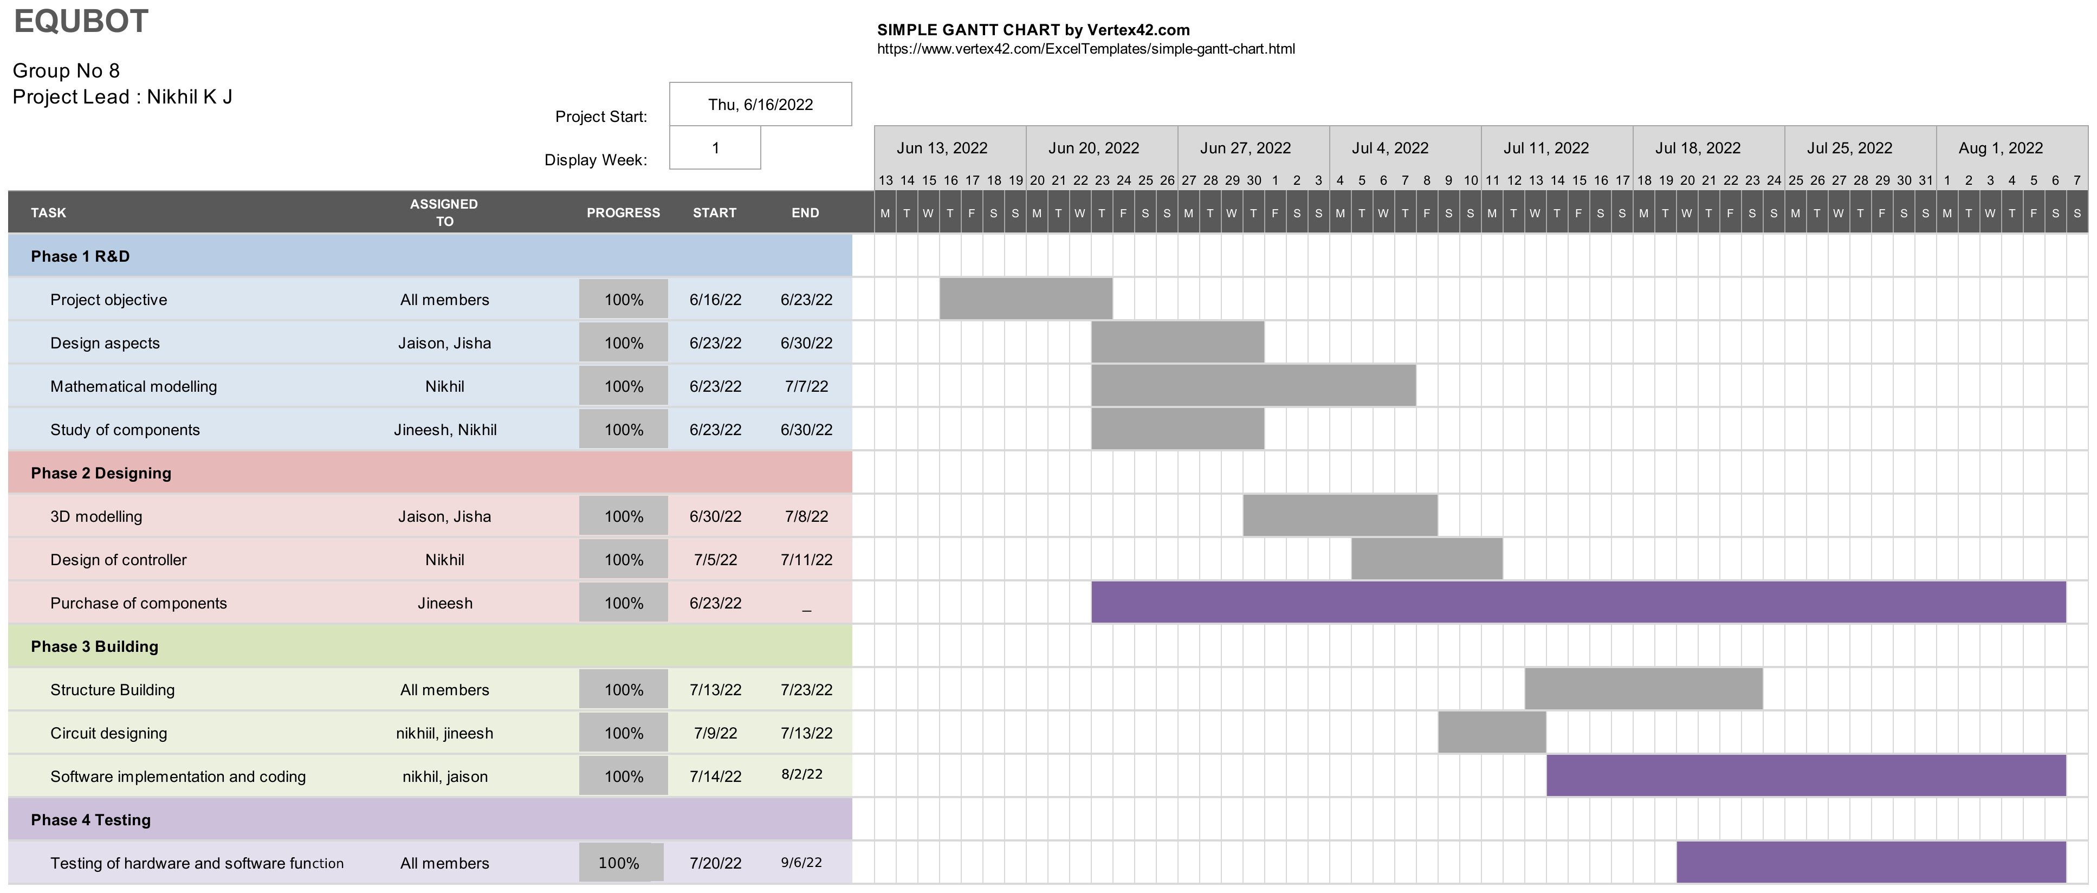
schedule

Slide 7
expenditure
COMPONENTS | RS.
Arduino Uno | 900
MPU6050 | 200+
Stepper motors + 2 WHEELS | 2500+
A4988 Motor Driver | 200+
Structure building | 1000+
Other Components | 1000+
Total | 5850+

Slide 8
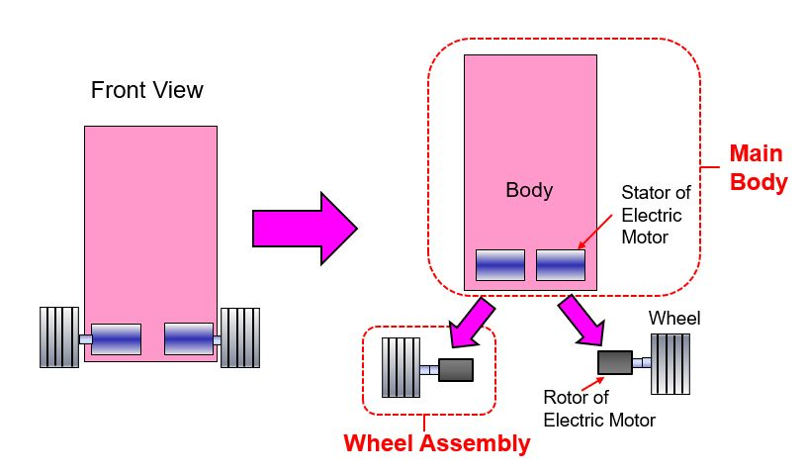
Literature survey
Mathmatical modelling

Slide 9
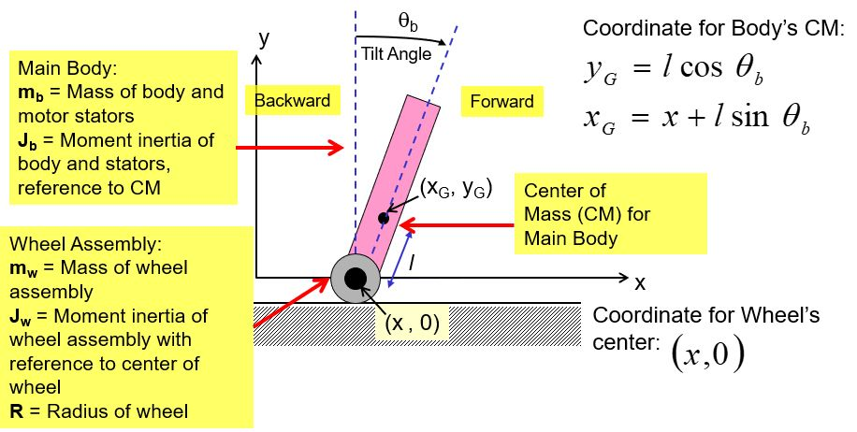
Literature survey
Mathematical modelling

Slide 10
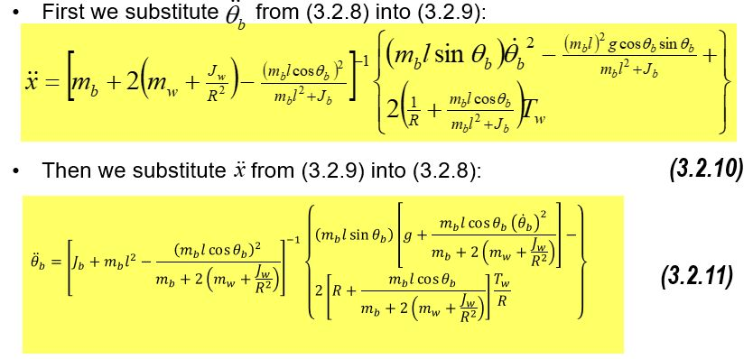
Literature survey
Mathematical modelling

Slide 11
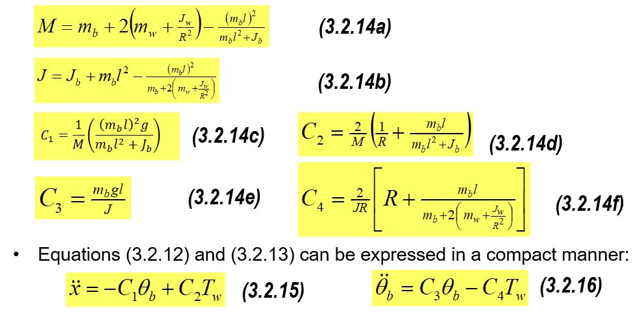
Literature survey

Slide 12
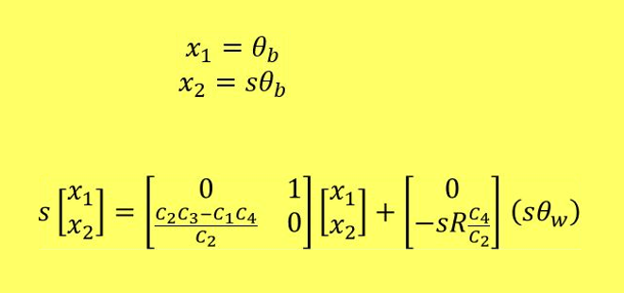
Literature survey
Mathematical modelling
Because the output torque of a stepper motor is almost constant, it is not very useful to achieve fine control of the TWSB robot state using equations mentioned, you either turn on the wheel motors at full torque or turn off the wheel motors with zero torque, unlike the brushed DC motor where we can adjust the output torque by adjusting the armature voltage supply va of the motors.
Instead the mechanical parameter that we can control effectively for brushless DC motor and stepper motor is the output shaft rotation speed or angle.

Slide 13
Literature survey
An, W.[4] derived mathematical models for PID and LQR control systems, simulated them in MATLAB, and concluded that LQR had better balancing performance than PID.
Jamil and …[5] developed a mathematical model with PID and LQR control systems, simulated them in MATLAB and Simulink, and concluded that PID controller is sufficient if robot has to only balance itself vertically and not move around; but if we want a robot which can balance itself vertically as well as move around, then we better go for LQR for best results.

Slide 14
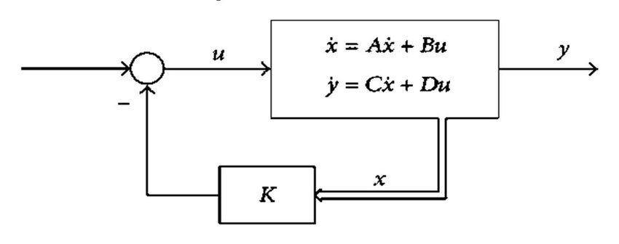
Literature survey
LQR Controller
Linear Quadratic Regulator
To control a linear system, LQR-control can be applied.
The states of the dynamical system are described by a state space model including the matrices A, B and C, D as seen in the figure below

Slide 15
Literature survey
Why stepper motor ?
Constant torque
High precision
This motor is like a brushless DC motor in which the complete turn is divided into several steps. Working in the correct operating range, they allow to maintain the position without usingencoders.
The speed of the motor can be controlled by means of a PWM signal y the direction with a digital signal using the micro stepping motor driver A4988

Slide 16
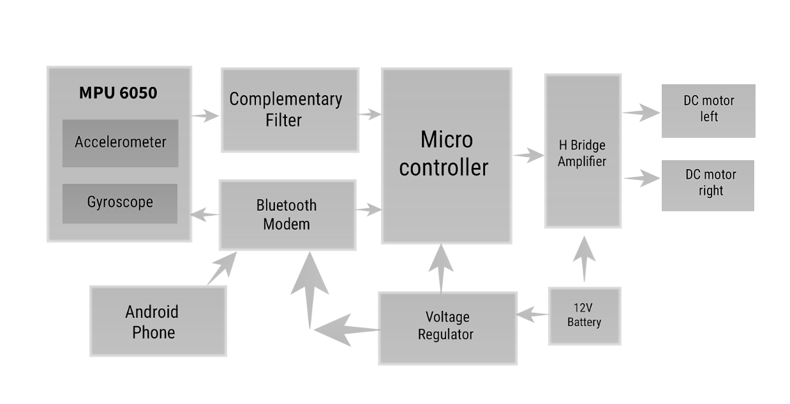
FLOWCHART
Motor Drivers

Slide 17
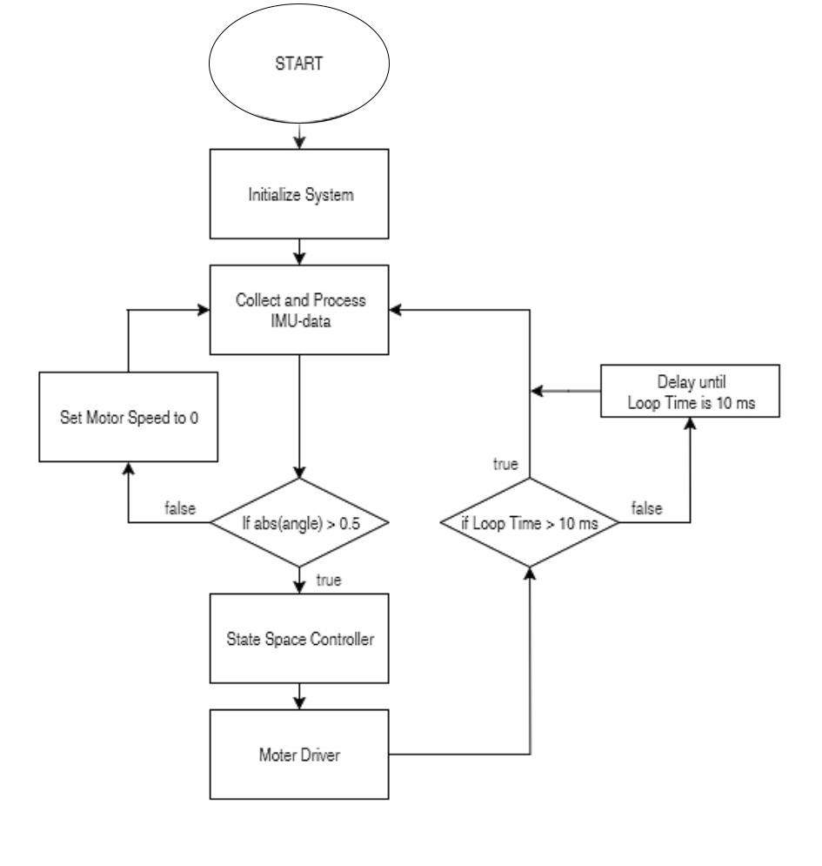
WORKING

Slide 18
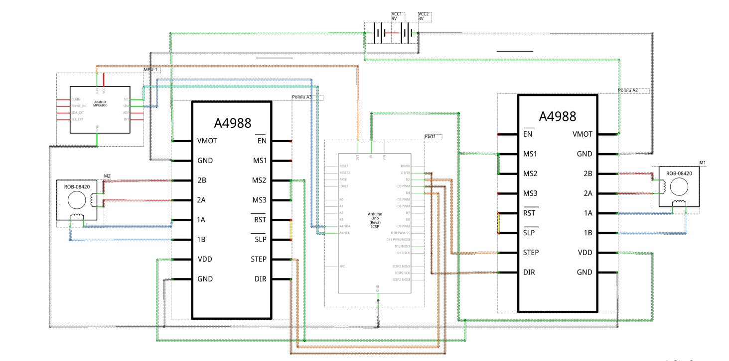
CIRCUIT DIAGRAM

Slide 19
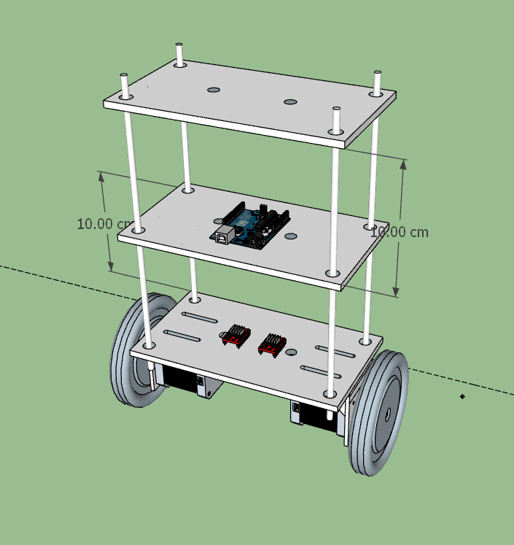
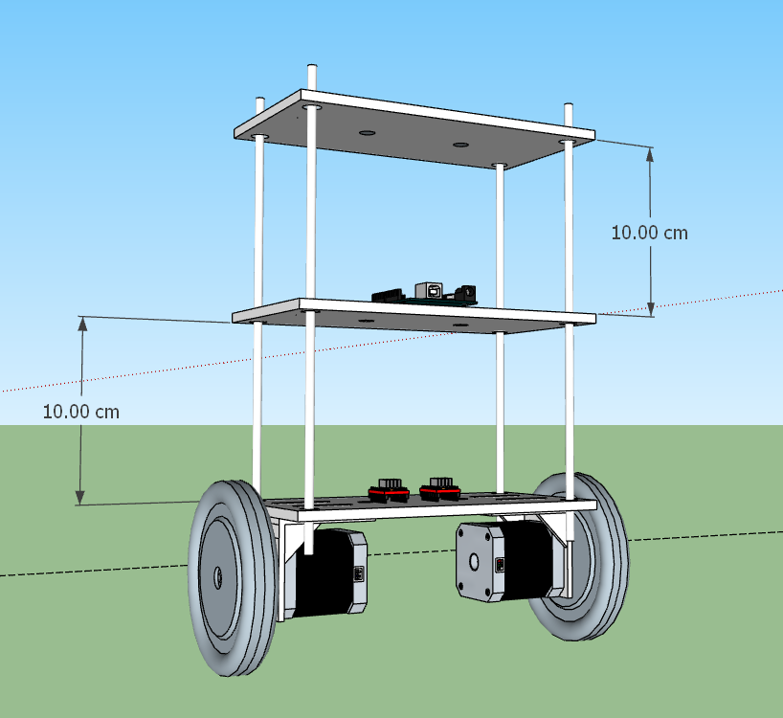
3D Design
Designn 1 (using m5 threaded rod)

Slide 20
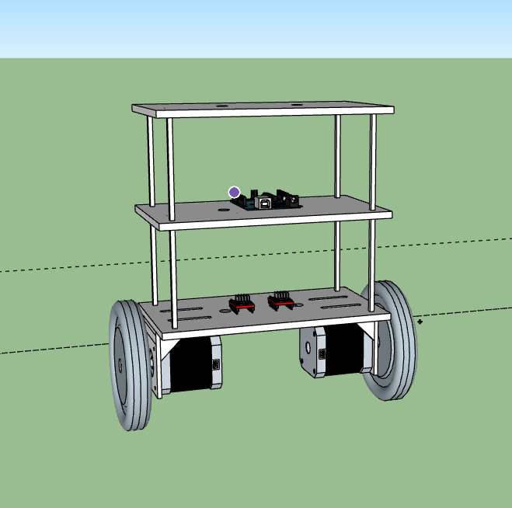
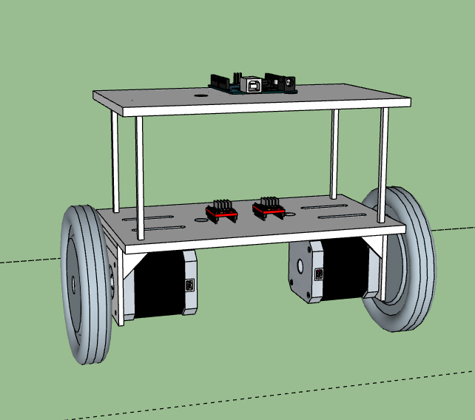
3D Design
Design 2
Design 3

Slide 21
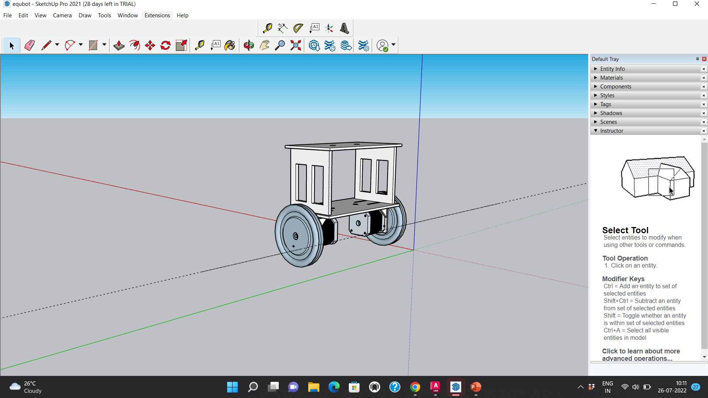
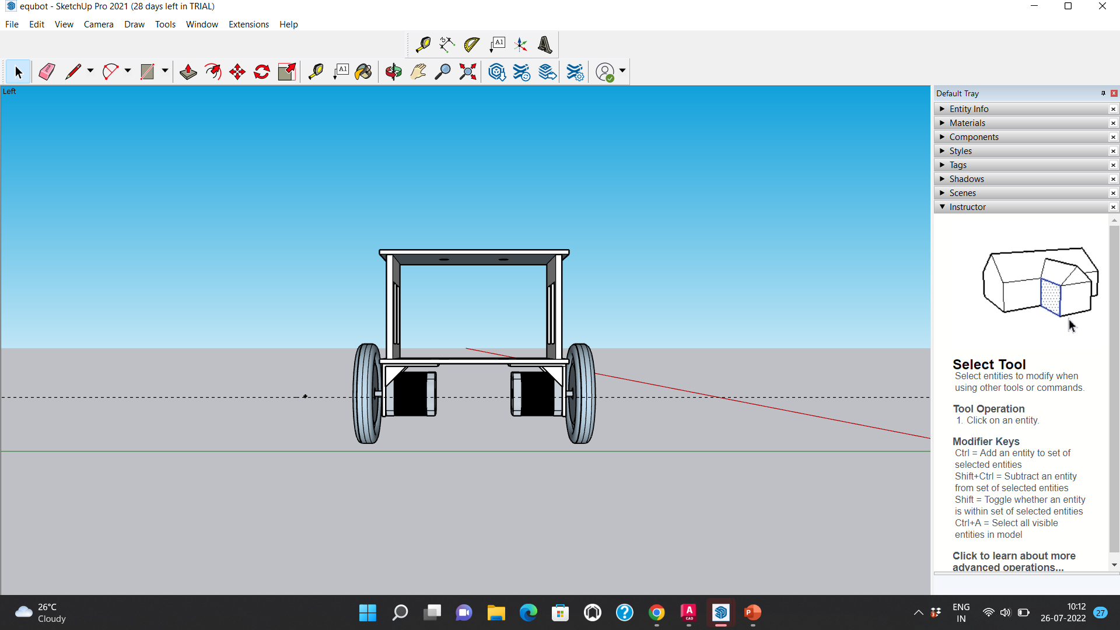
3D Design
Design 4

Slide 22
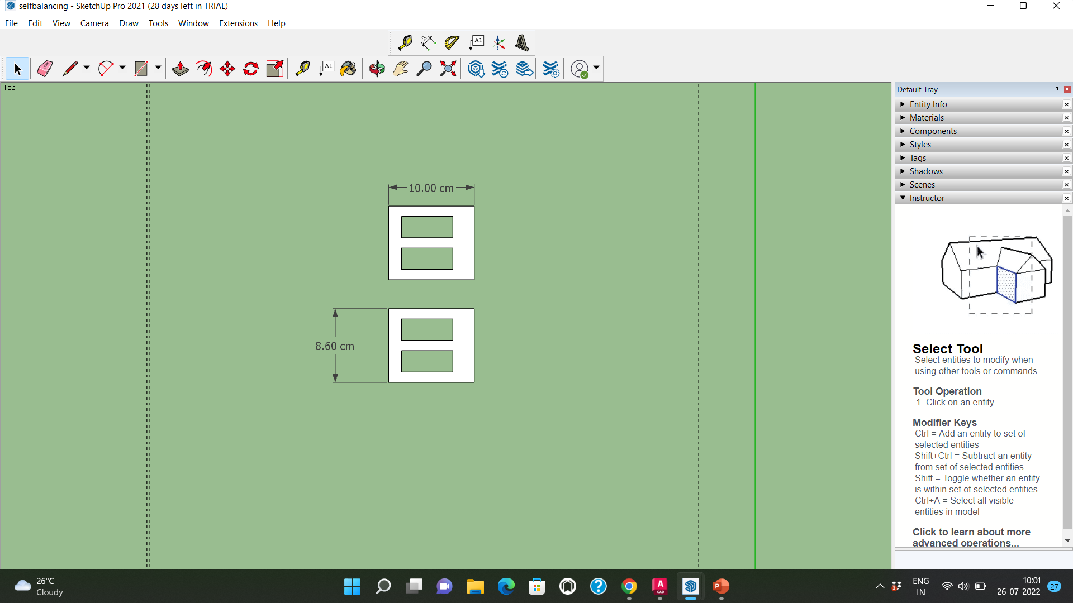
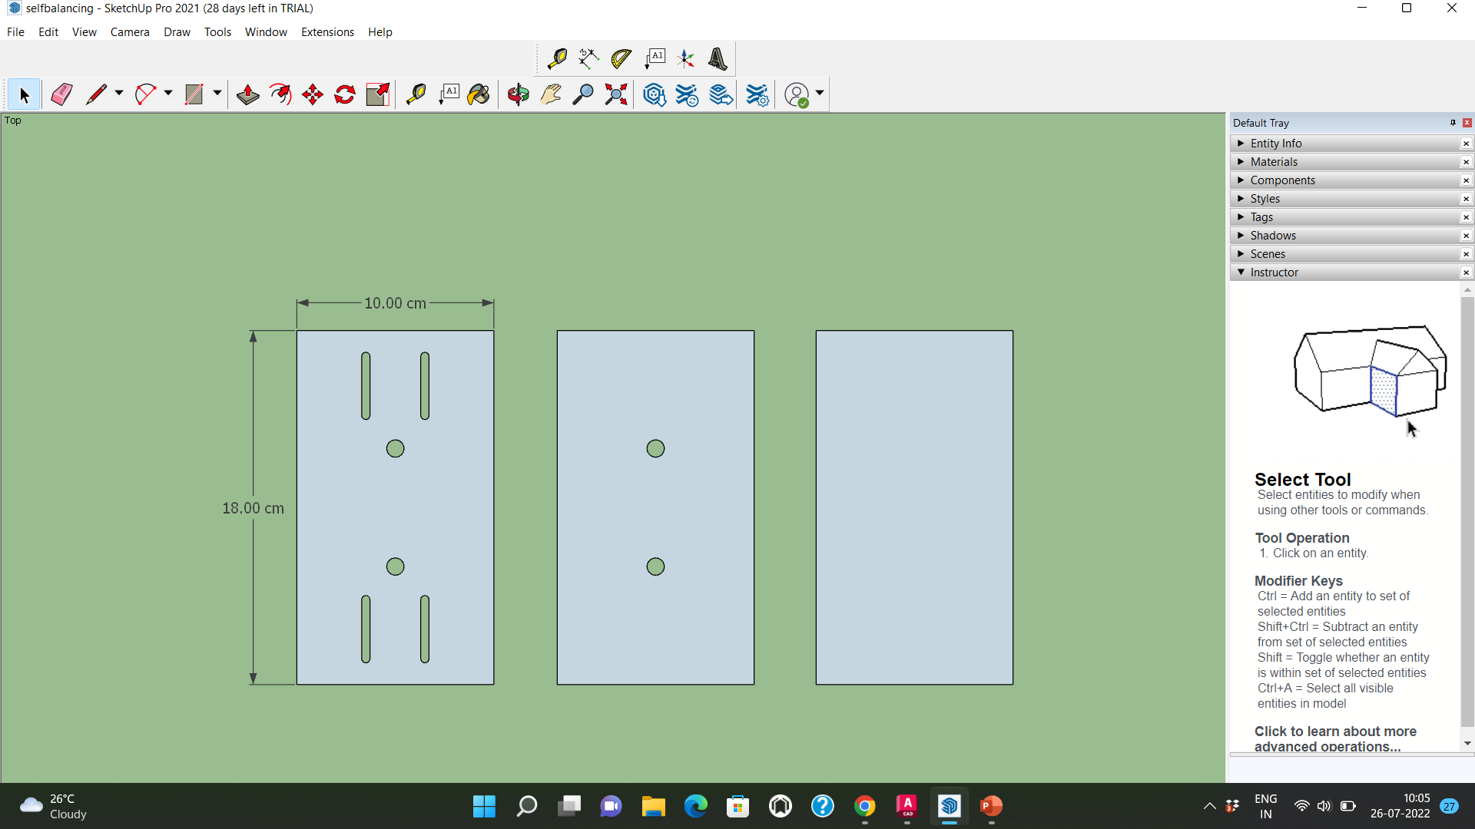
3D model
Base Platform
Side platform

Slide 23
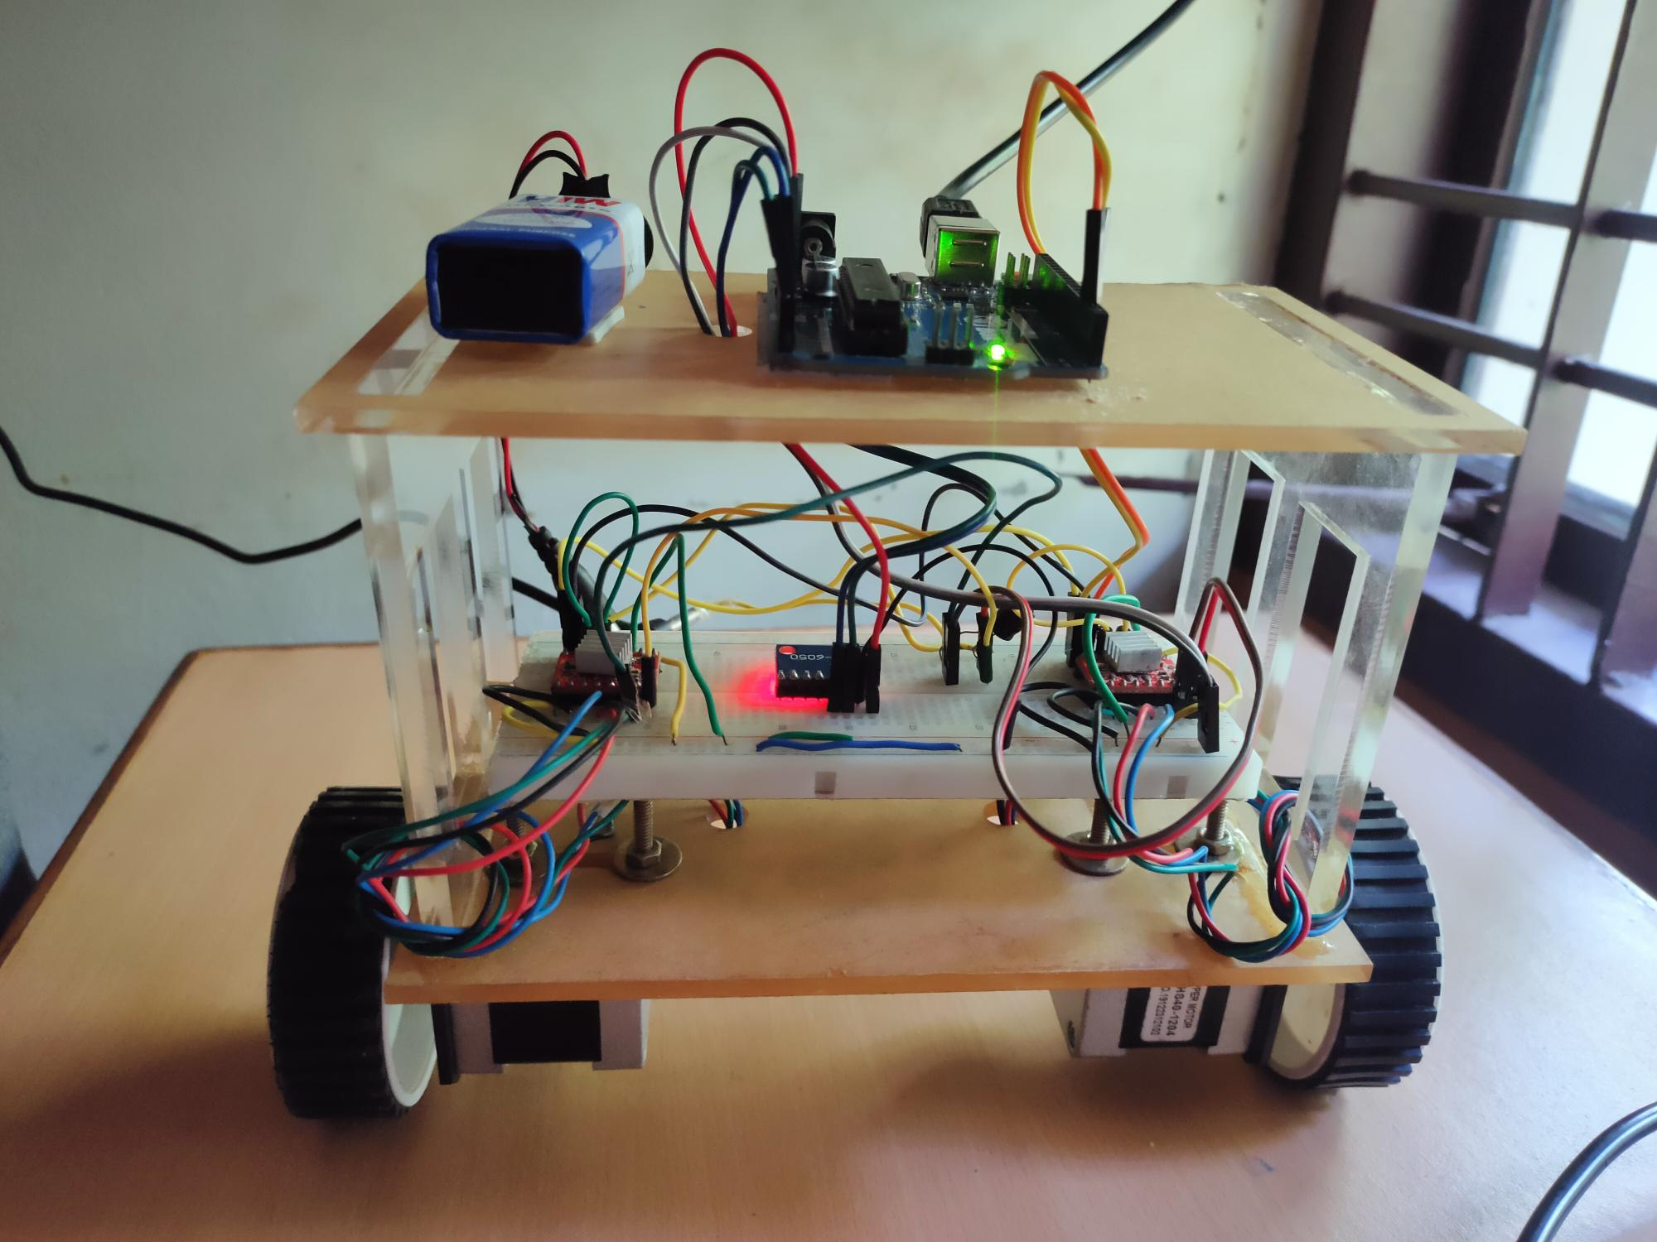
Structure of the robot

Slide 24
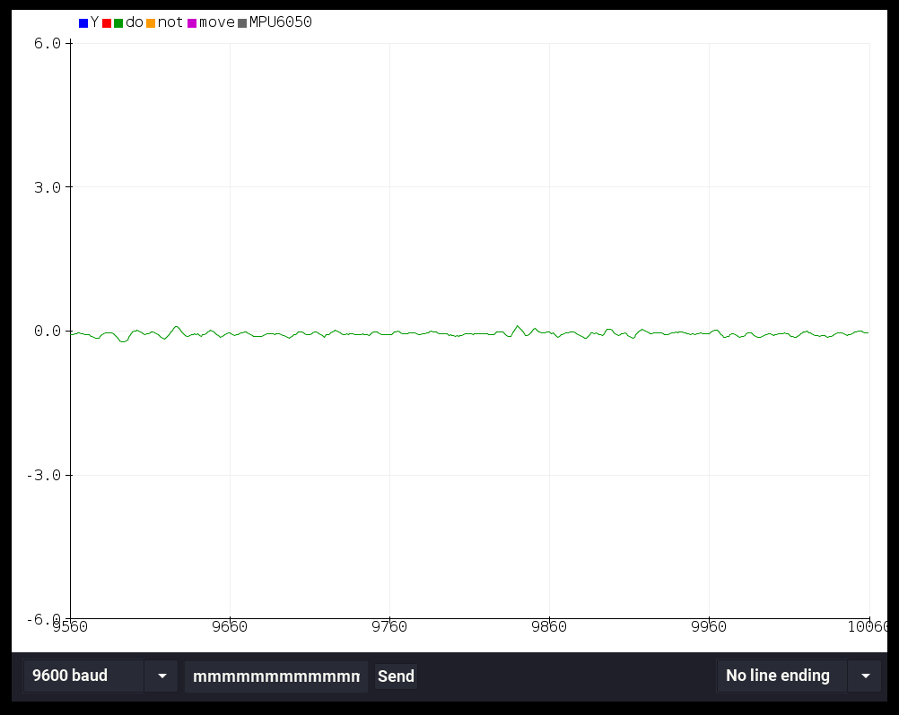
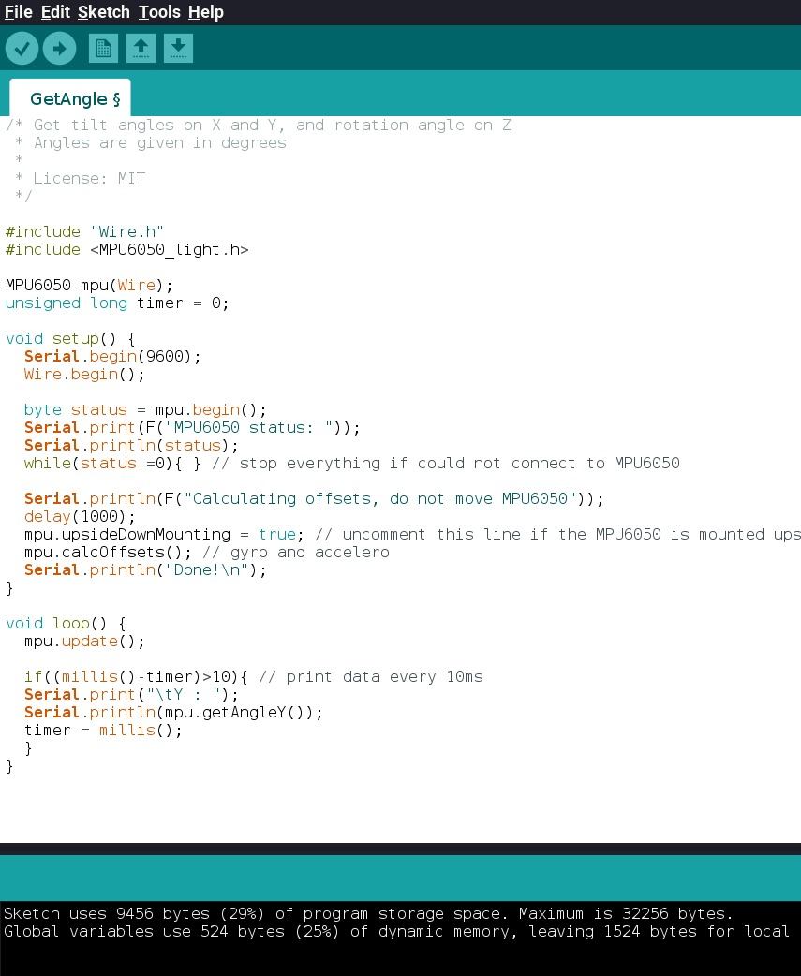
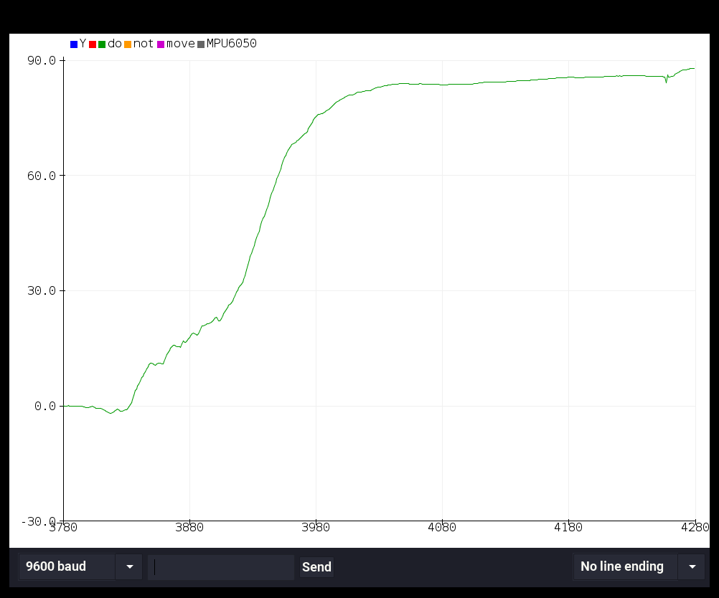
MPU6050 SIMULATION

Slide 25

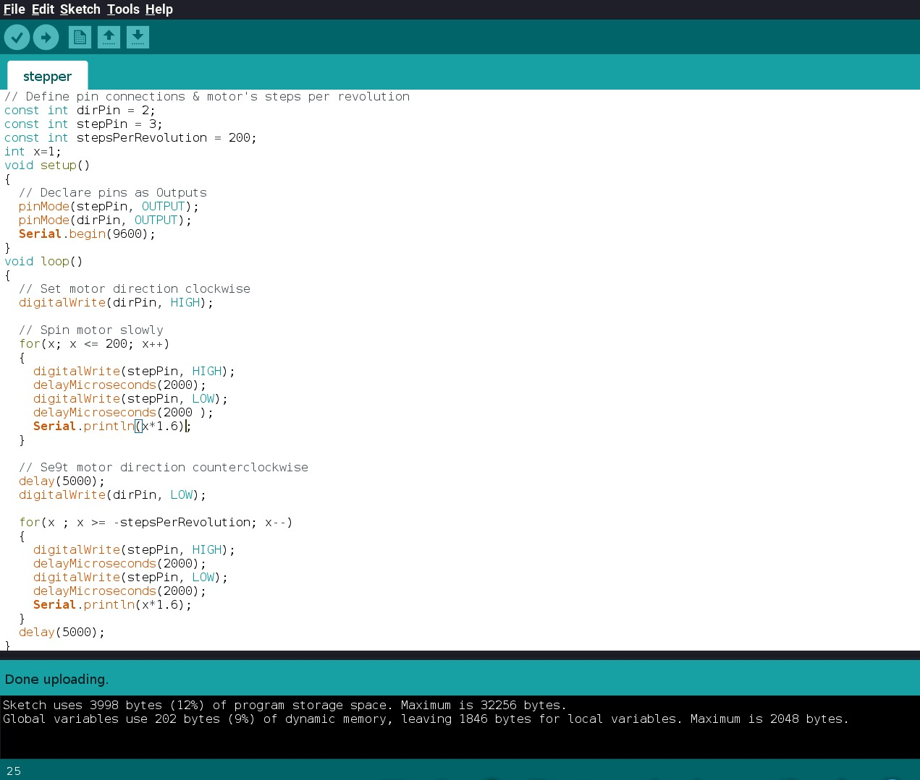
Stepper Motor simulation

Slide 26
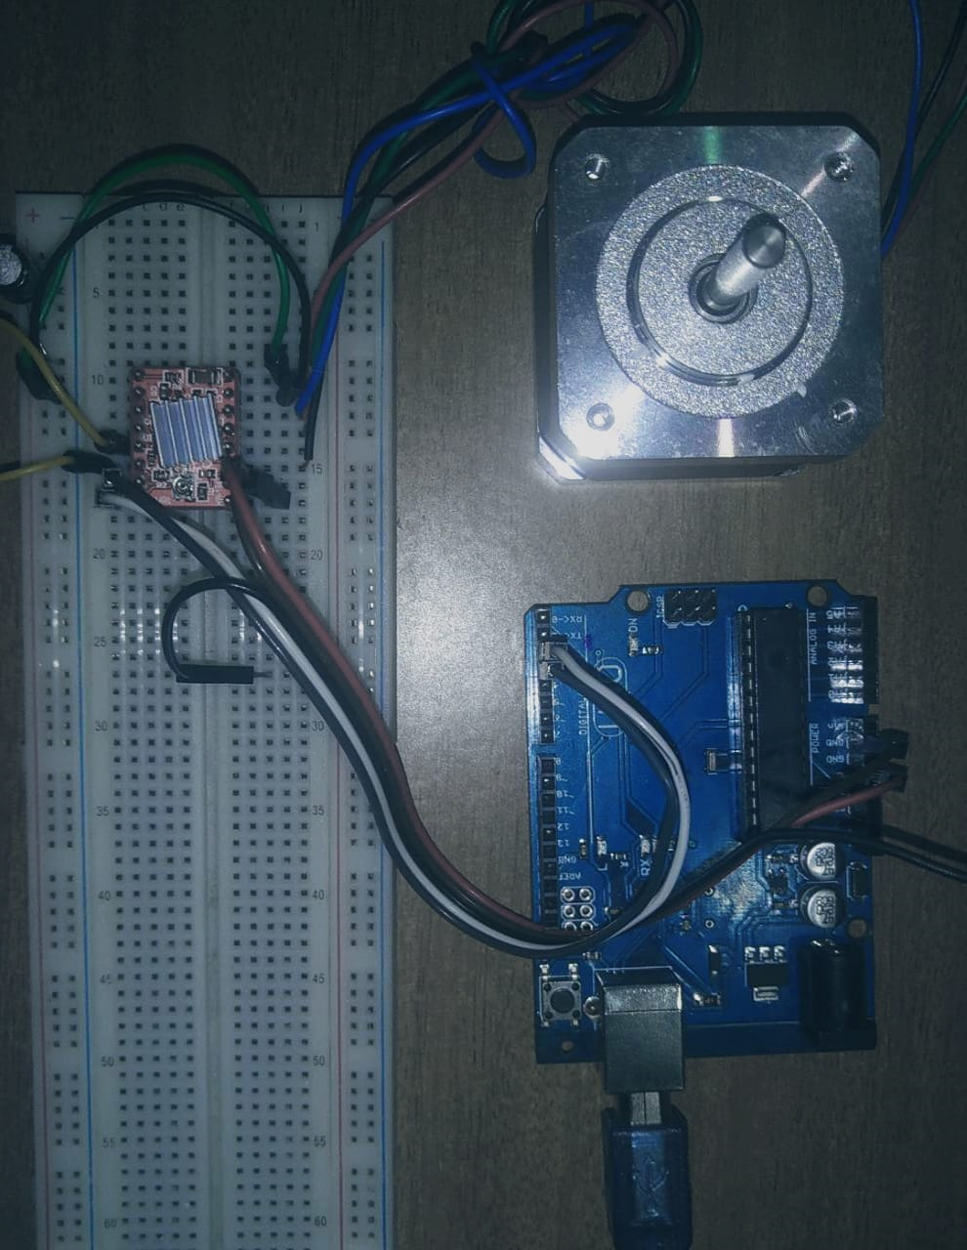
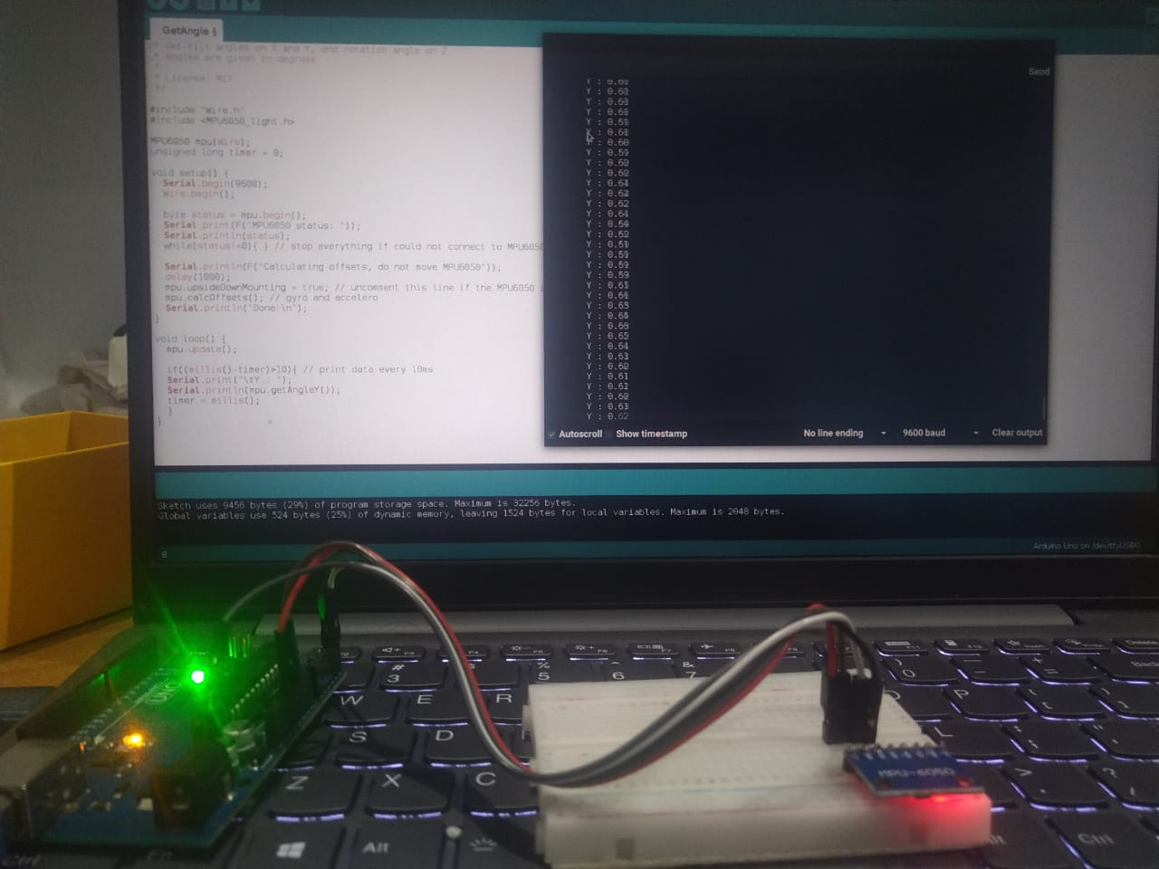
Stepper motor Interfacing

Slide 27
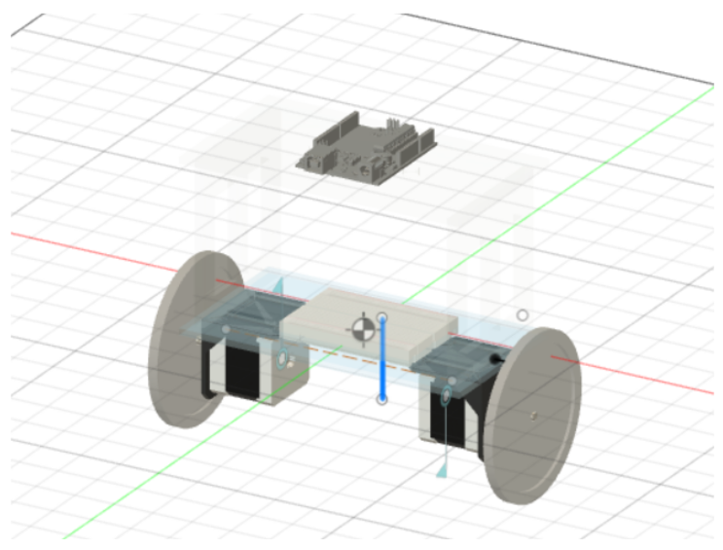
Finding the center of mass of the robot
Center of mass of the system is calculated with the help of a simulation software called Fusion 360

Slide 28
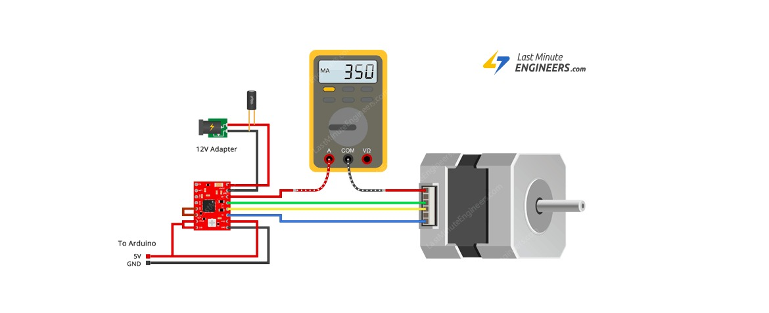
A4988 interfacing Current Limiting

Slide 29
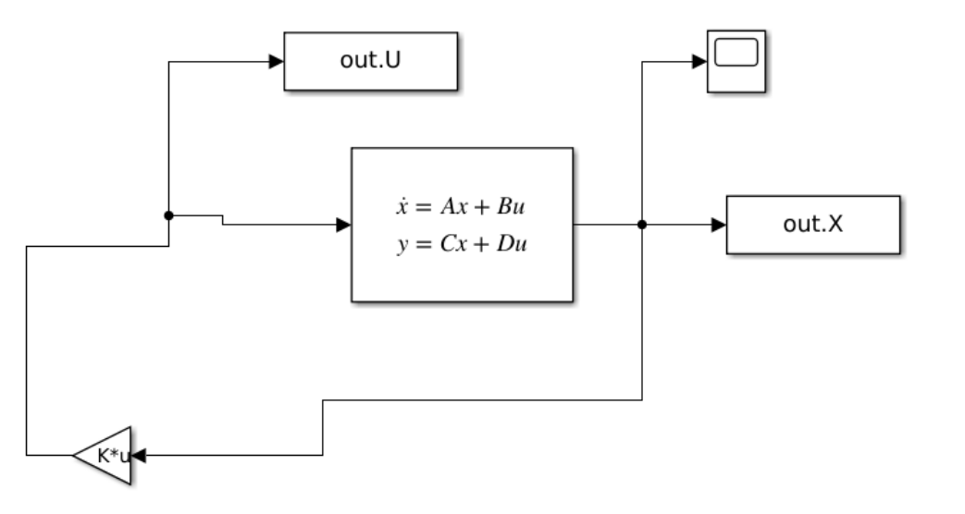
MATLAB SIMULINK Model
The LQR gain K is calculated using MATLAB.
This gain K is validated using the SIMULINK model.

Slide 30
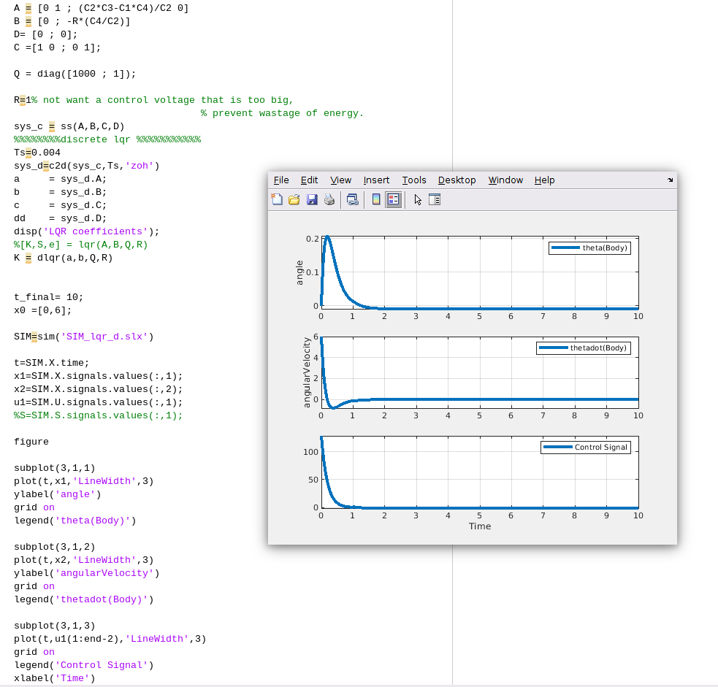
Initially the angle of system is set to 6 degree and it is simulated. Here We observe that the system regain balance after 0.5 second. Also the control signal increases and returns to 0 when the system is balanced.

Slide 31
REFERENCE
Laubli, David; Garabedian, Thomas; Paul, Jordan; Patel, Nikheel; and Redle, Michael, "Self-Balancing Two Wheeled Robot" (2015). Honors Research Projects. 65. http://ideaexchange.uakron.edu/honors_research_projects/65
Modelling & Simulation for Optimal Control of Nonlinear Inverted Pendulum Dynamical System using PID Controller & LQR https://www.researchgate.net/publication/261460141_Modelling_and_Simulation_for_Optimal_Control_of_Nonlinear_Inverted_Pendulum_Dynamical_System_Using_PID_Controller_and_LQR
Sun, C., Lu, T., Yuan, K., “Balance control of two-wheeled self-balancing robotbased on Linear Quadratic Regulator and Neural Network”, 2013. IEEE, 4th International Conference, Intelligent Control and Information Processing(ICICIP), China.
An, W., Li, Y., “Simulation and control of a two-wheeled self-balancing robot”,2013. Proceeding of IEEE, International Conference, Robotics and Biometrics(ROBIO), China.
Jamil, O., Jamil, M., Ayaz, Y., Ahmad, K., “Modeling, Control of a two-wheeled self-balancing robot”, 2014. IEEE, International Conference, Roboticsand Emerging Allied Technologies in Engineering (iCREATE), Pakistan.

Slide 32
Thank you

